Slide 1
Bank Customer Churn Prediction and Customer Churn Segmentation
Shabrina Azalia Aikadina
Job Connector Data Scientist Batch 8

Slide 2
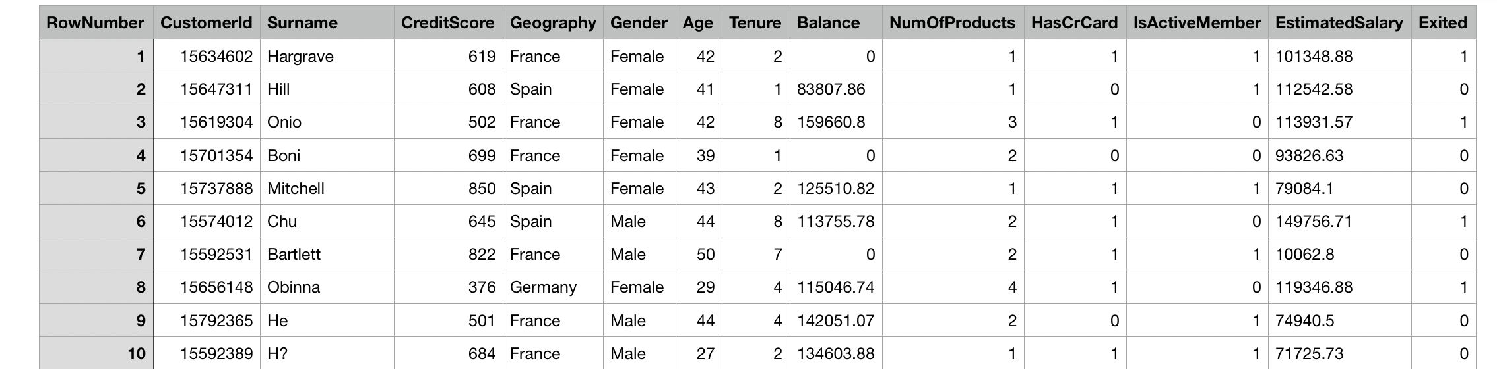
Dataset Source
Kaggle
https://www.kaggle.com/shrutimechlearn/churn-modelling
Bank Customer Churn
This data set contains details of a bank's customers and the target variable is a binary variable reflecting the fact whether the customer left the bank (closed his account) or he continues to be a customer.
Dataset Information:
10.000 Rows
14 Columns

Slide 3
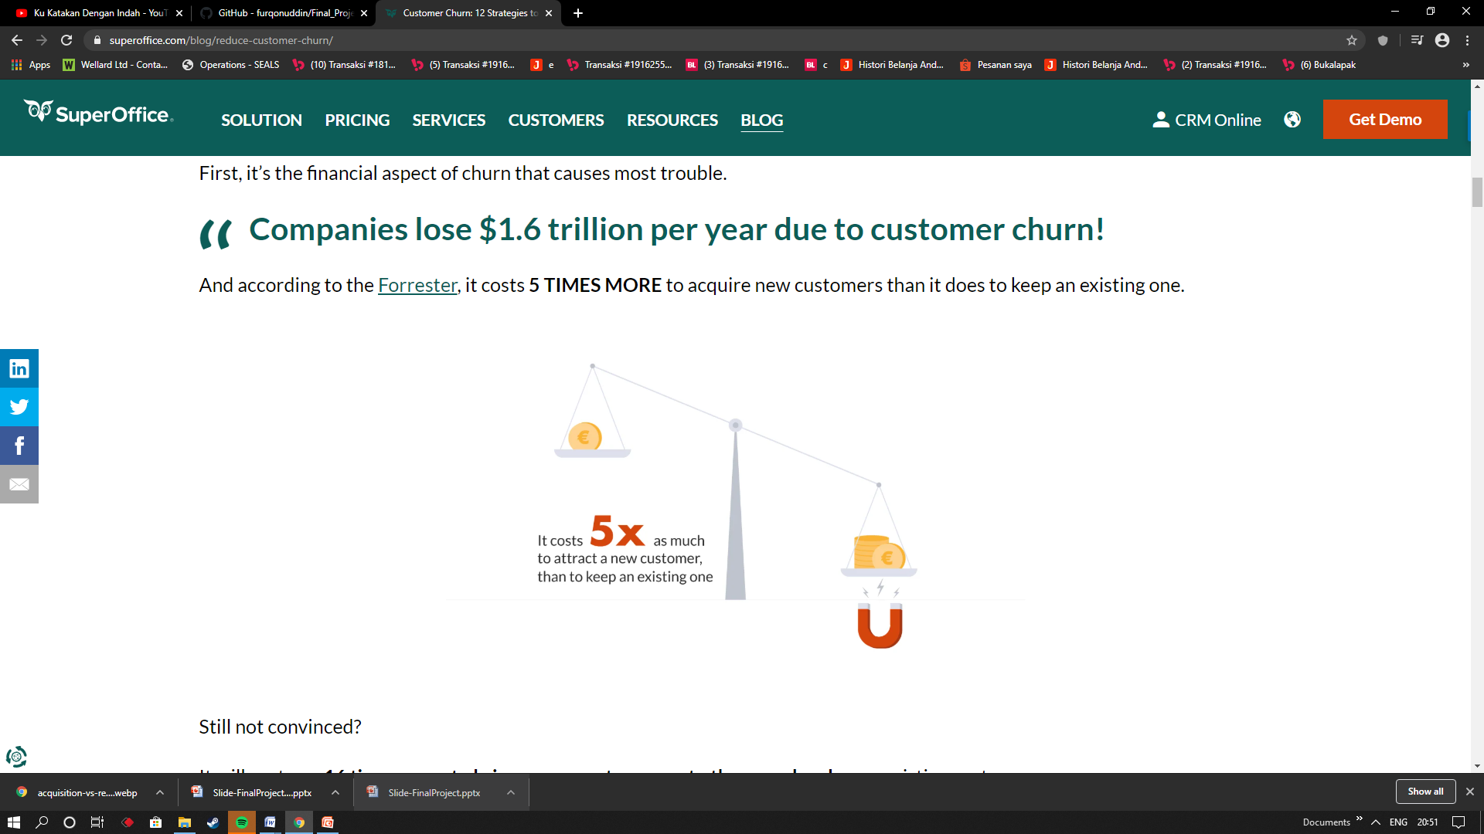
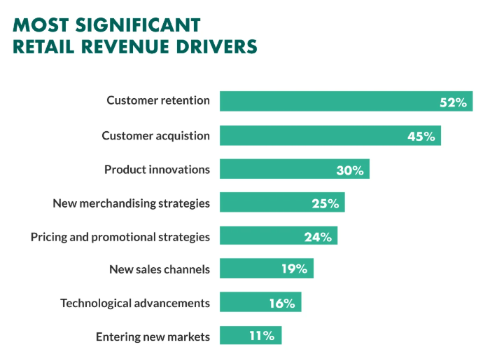
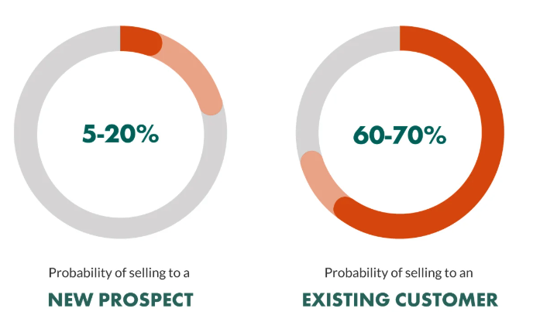
Project Background
Costumer churn also known as customer attrition, in its most basic form, is when a customer chooses to stop using your products or services.
Reasons why churn often in first place in company’s problem:
According to the Forrester , it will cost you 16 times more to bring a new customer up to the same level as an existing customer.
The Harvard Business School report claims that on average, a 5% increase in customer retention rates results in 25% – 95% increase of profits.
The lion’s share – 65% of a company’s business comes from existing customers!

Slide 4
Machine Learning Benefits
This machine learning give some benefits to Bank Company
Classification:
Boost Profits: Selling to existing customers is easier and more cost effective rather than selling to new ones.
Retain More Customers: Proactively launch campaigns and strategies to abate customer attrition.
Win Back Business: Identify the root causes as to why customers leave and establish re-acquisition strategies.
Avert Loss: Customer loss is substantial, long-reaching, and can impact everything from revenue to opportunity for competition.
Clustering:
Customer Segmentation is the subdivision of a market into discrete customer groups that share similar characteristics. Using data, companies can then outperform the competition by developing uniquely appealing products and services.Here, we will cluster valuable costumer that tend to churn. So company could give them more attention. Because, those customer bring more revenue for company.

Slide 5
Final Project
Classification Model
1. Data Cleaning & Preparation
- Handling Missing Value
- Encoding Categorical Data
- Feature Selection
- Handling Outlier
- Feature Scaling
2. Exploratory Data Analysis
3. Machine Learning Model Building
There are 2 datasets, dataset with default numerical data and dataset with scaled numerical data
- Split 90% and 80% Train Data
- Oversampling using Synthetic Minority Over-sampling Technique
- Logistic regression, Random Forest, KNeighborsClassifier
- Hyperparameter Tuning using GridSearchCV and RandomizedSearchCV
- Model Evaluation

Slide 6
Classification Model Result
After some experiments in building model. We found that KNeighborsClassifier with 90% data train after SMOTE which numerical featues have been scaled is the best model. Because it has highest recall 0.67 (67%). Actually we need to improve it, because churn problem really affect bank’s revenue and marketing cost.
For improve model accuracy and recall, we need to add more data or add more features ex. Marital Status, Employment Status, Number of Customer Service Calls that customer made.

Slide 7
Clustering Model
Data Preparation
Clustering using KMeans
- Count Best k value for training KMeans Model using Elbow Method
- Fitting KMeans Model
- Predict and plotting cluster
- Cluster Exploration

Slide 8
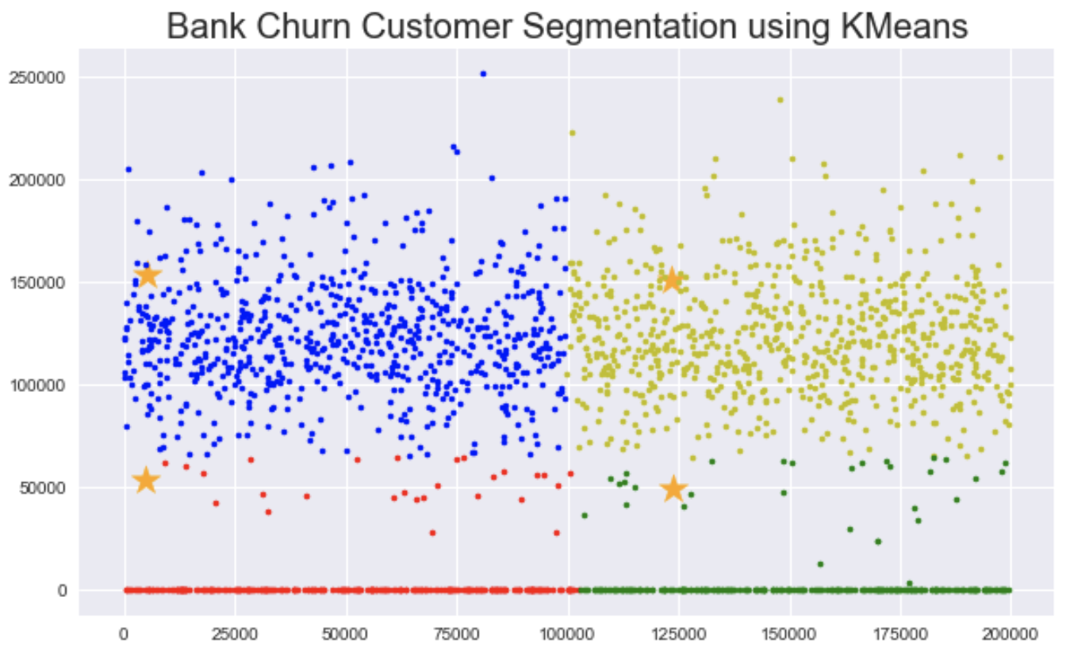
Clustering Result Salary and Balance

Slide 9
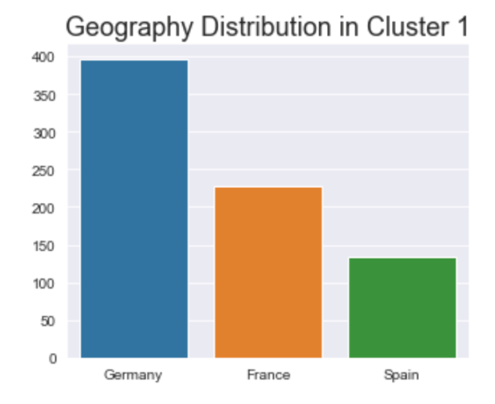
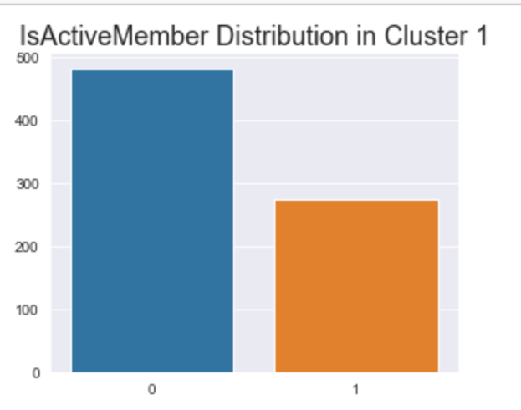
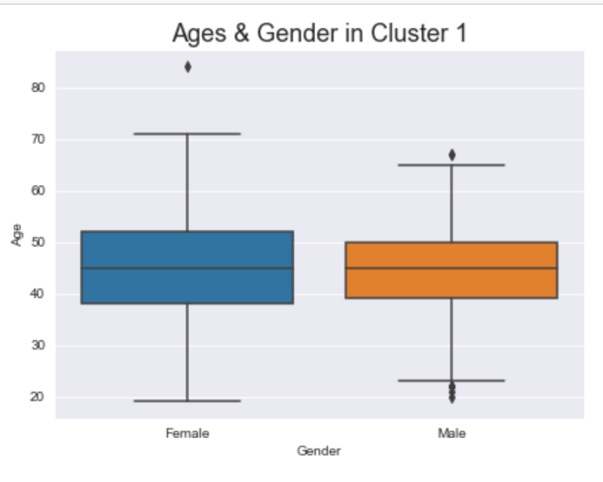
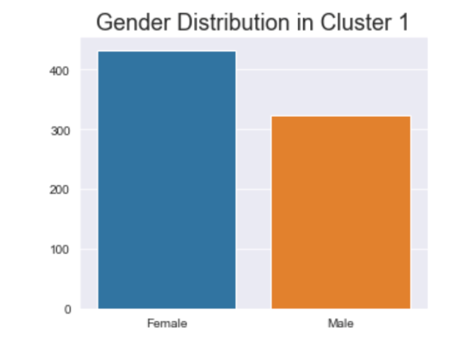
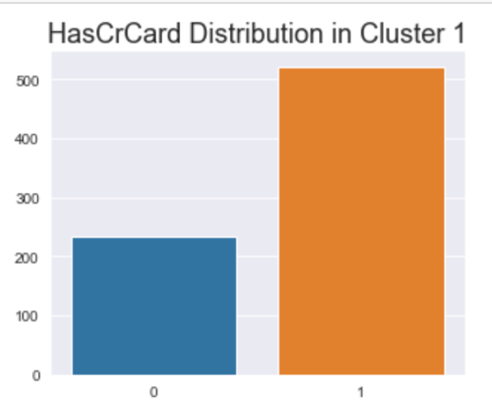
Cluster 1 Exploration

